Slide 1
CS499 Motor Speed Control
By Yuyang Feng, Ruoyu Ma, and Mamuerbieke Jieensi

Slide 2
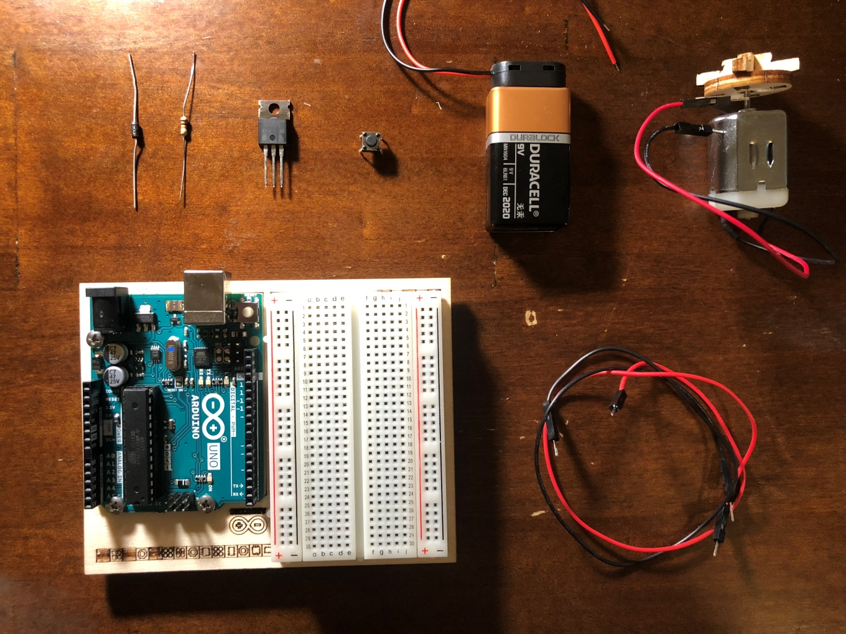
Components
Diode
Resistor
MOSFET
H-Bridge
9V Battery
DC Motor
Wires
Board

Slide 3
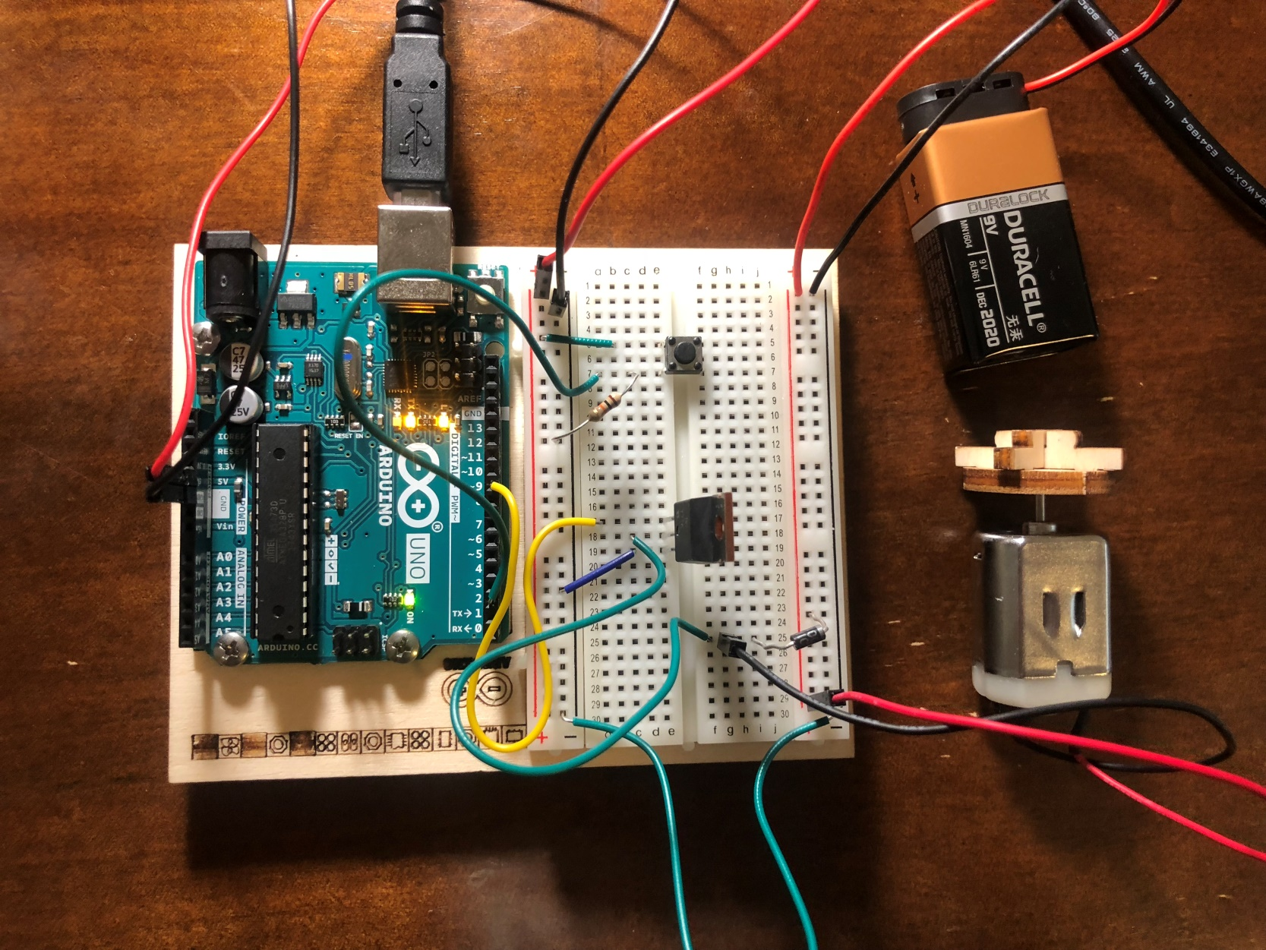
Circuit

Slide 4
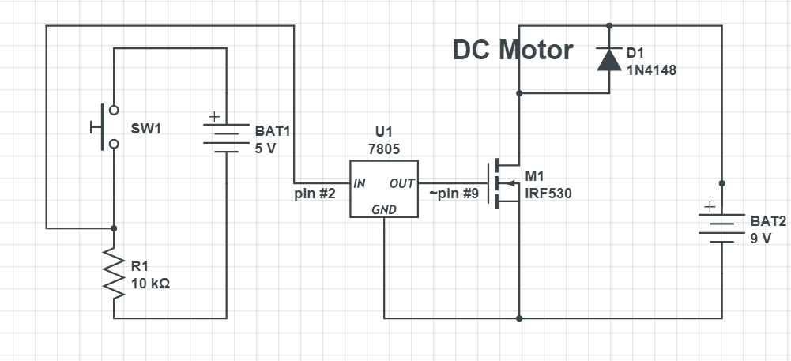
Schematic

Slide 5
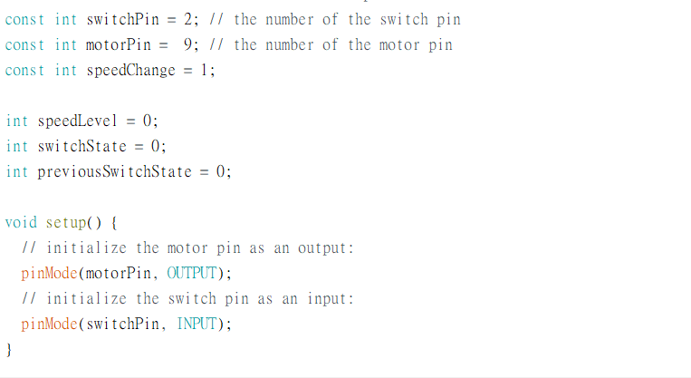
Code

Slide 6
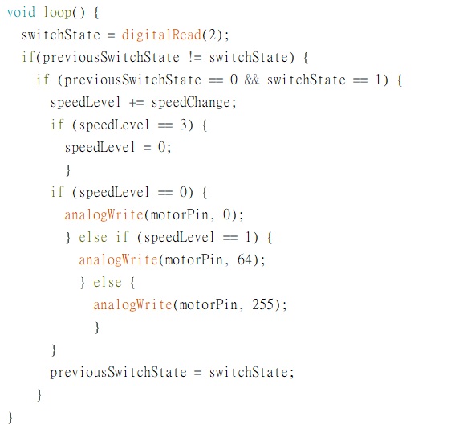
Code (cont.)

Slide 7
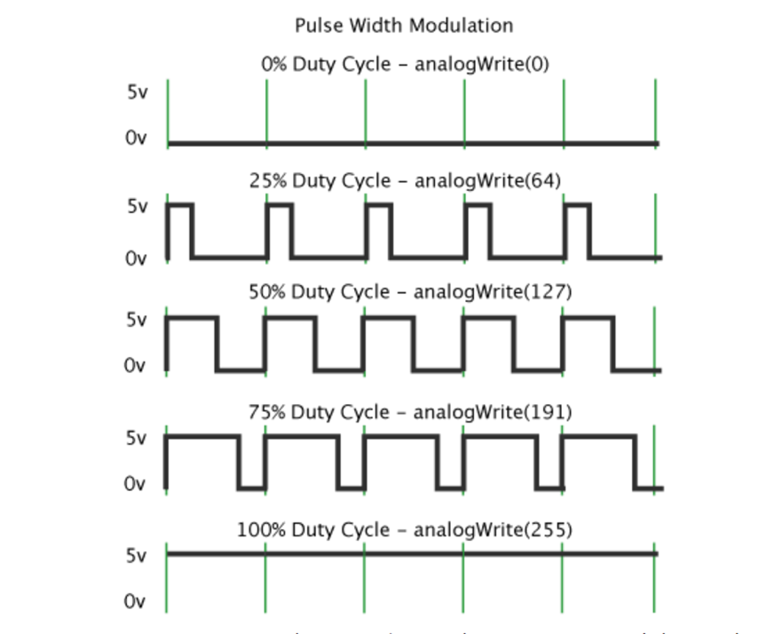
PWM Waves

Slide 8
Demo

Slide 9
Questions?

